Slide 1


Airport Baggage Security Check Analysis

Slide 2
Content of the presentation
A | Project Goals
B | CRISP-DM Methodology
 | 1– Business Understanding
 | 2– Data Understanding
 | 3– Data Preparation
 | 3.1 Data cleansing – by inbuilt data Interpreter of Tableau
 | 3.2 For Handling missing values– Filter in Tableau Data Source
 | 3.3 Outlier Treatment– Identified and eliminated
 | 3.3 Outlier– L2,L3 Login ID
C | Technical Stacks
D | Business Overview
 | Business Overview : L2Login ID
E | Calculated Fields and Parameters
F | Objective :Operation performed on the Baggage
 | Project Architecture / Data Pipeline
 | Avg Time taken at L2Decision by L2Login ID
 | Avg Time taken for L3Decision by L3Login ID
G | Final Inferences
H | Future scope

Slide 3

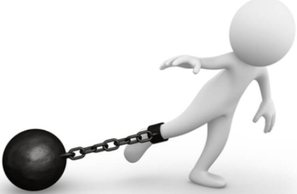
Project Goals
Objectives
Constraints
Operations based on machines, time taken.
Operations based on Login ids/, time taken.To find out total operation performed on the baggage
To identify the status & time limits
To minimize the bag inspection time.
Suggestion for the optimum way to maintenance of the machines.

Slide 4
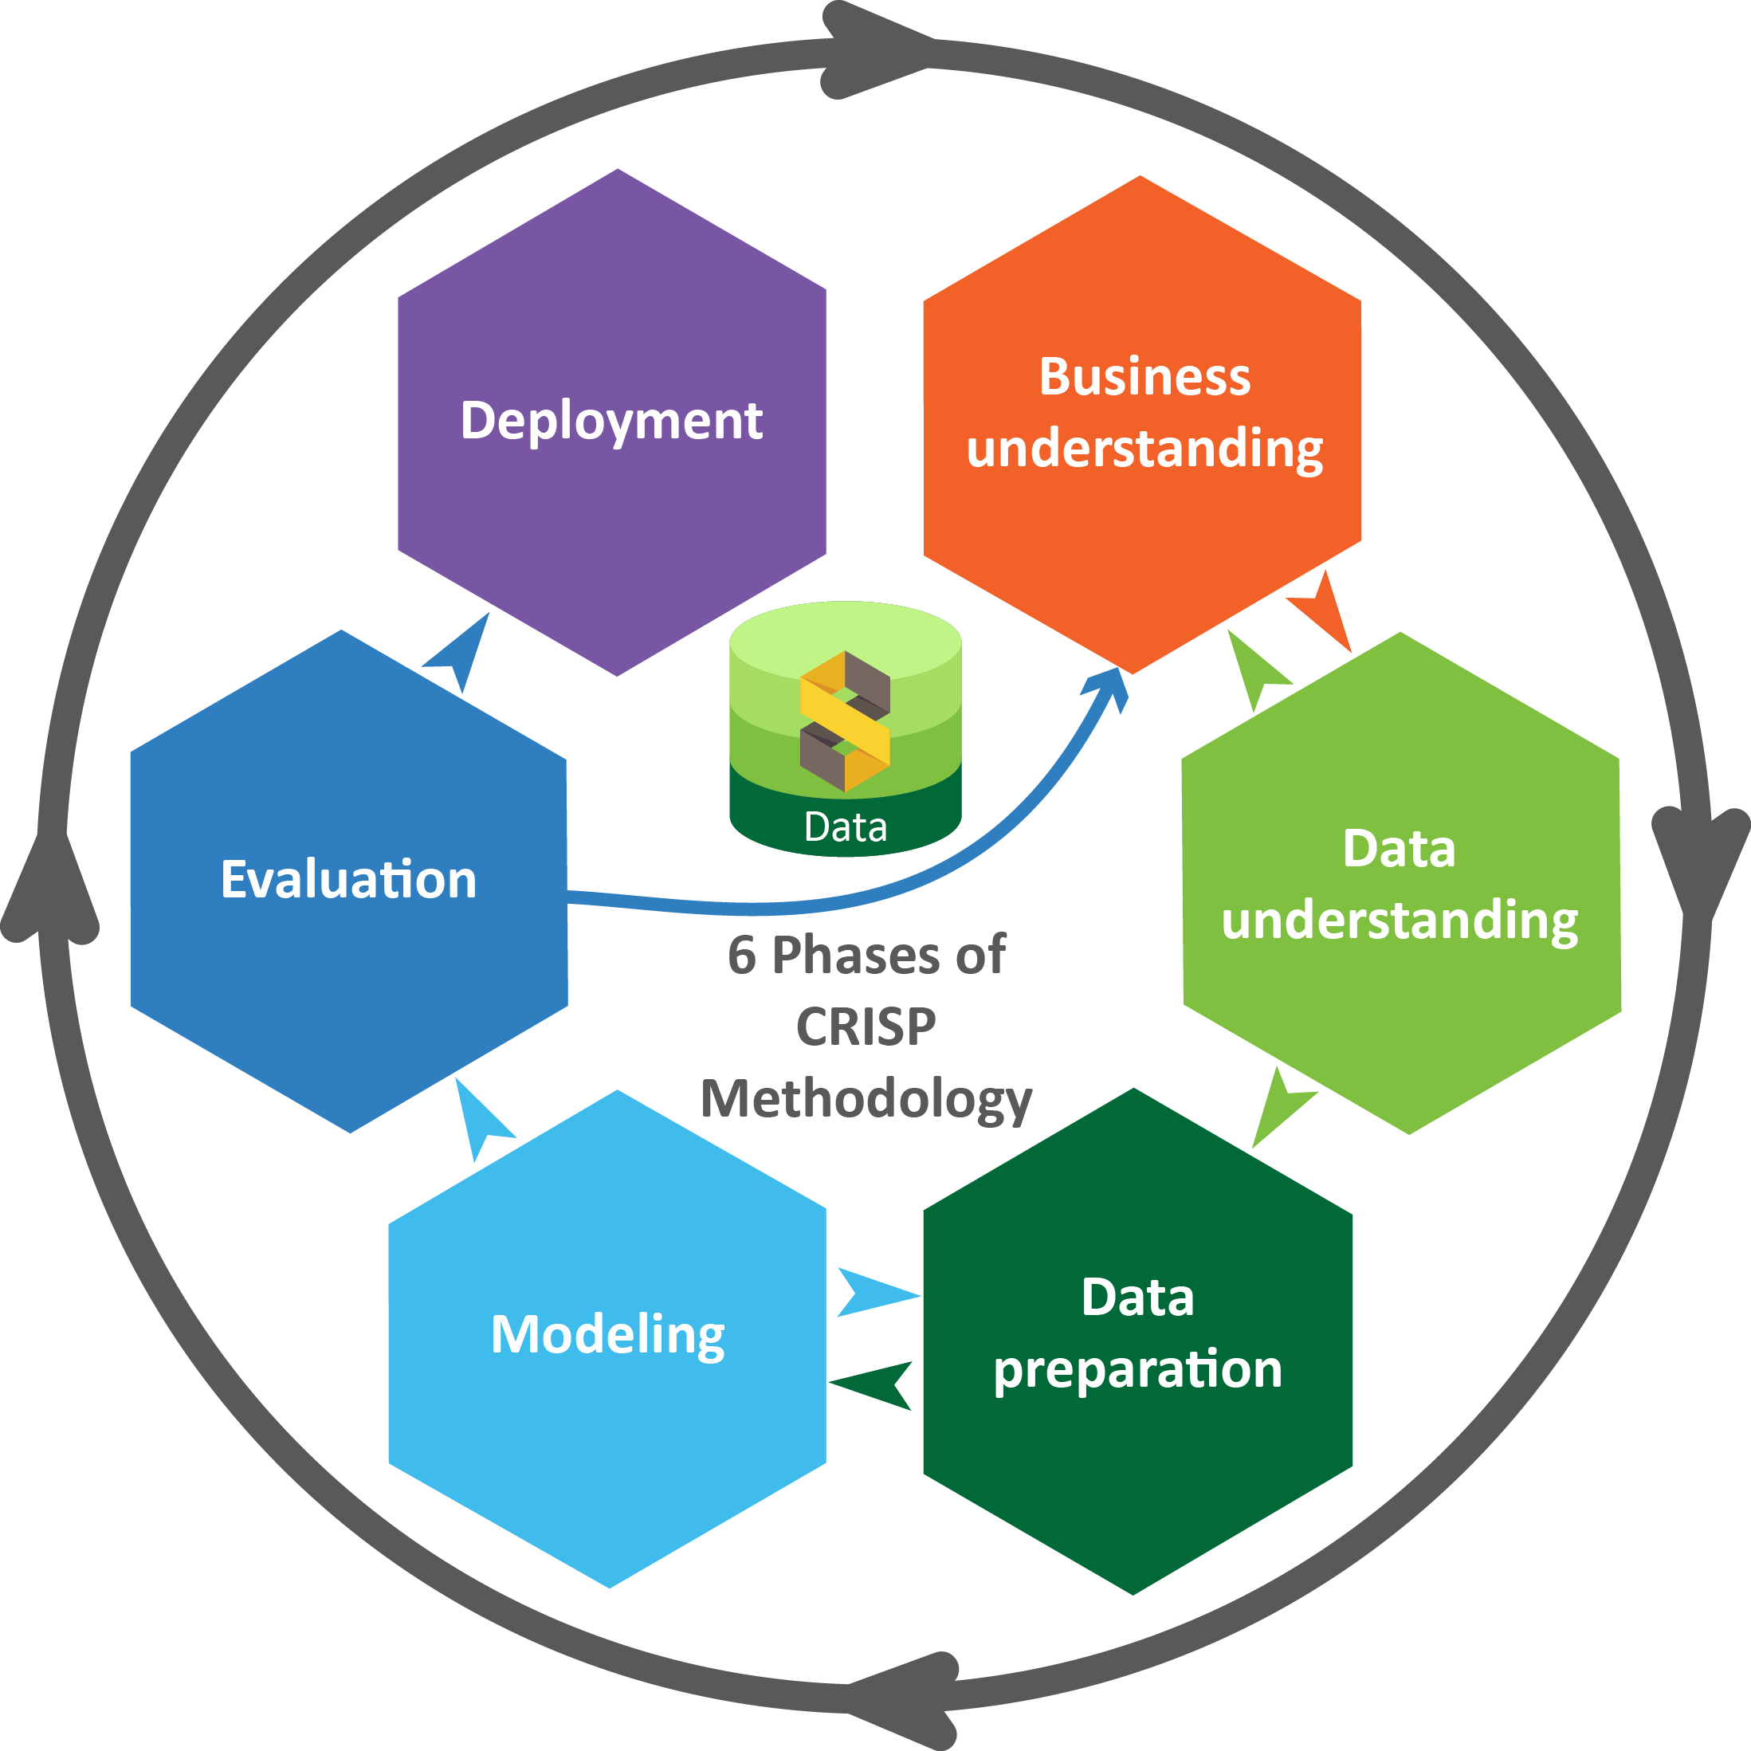
Business pipeline: CRISP-DM Methodology

Slide 5
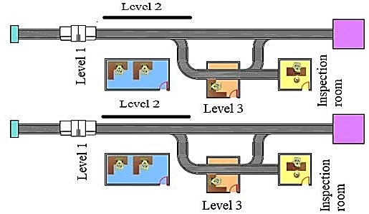
1. CRISP-DM Methodology – Business Understanding
 | Description
Step – 1 | The baggage handling system starts when the passenger checks in with the bag
Step – 2 | The bag is weighed and tagged with an Bag ID’s/BHS ID’s/ Login ID’s which is used to track it through to its destination
Step – 3 | The bag travels through a conveyor system which performs multiple levels of screening checks on the bag, these checks are a combination of automated and manual inspection
Step-4 | Airline Surveillance for baggage
Overview of the airline baggage screening system at various levels

Slide 6
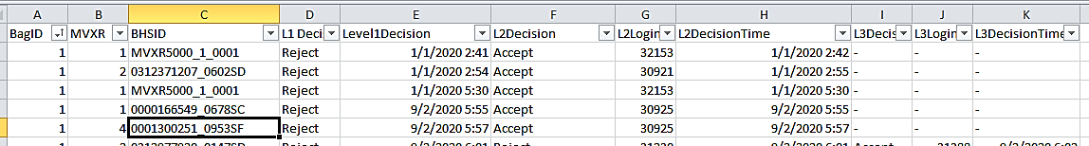
2. CRISP-DM Methodology – Data Understanding
Labels | Description
Bag ID | Tracking ID for Bags
XBIS | Multilevel X-ray Machine, a total of 4 XBISs deployed at the Airport for scanning bags at Level 1 and Level 2
BHSID | Unique tracking ID assigned to the bags
L1 Decision | All the bags get rejected at this level
L2 Decision | Post automatic scanning, bags get rejected, accepted, default reject and time out
L3 Decision | Post L2 decision, L3 decision is also a manual screening. The Status after final screening are Accept, Reject, Default Reject and Time out
L1, L2 and L3 Decision Time | Time taken for each baggage at L1, L2 & L3
L2 Login ID | Operator Login ID at L2 decision
L3 Login ID | Operator Login ID at L3 decision

Slide 7
3. CRISP-DM Methodology – Data Preparation
Number of observation and 11 features
Data cleansing
And additional steps for data preparation
Data cleansing – using inbuilt data Interpreter of Tableau
Data Cleansing – Using Excel date and time formatting
For Handling missing values– Filter in Tableau Data Source
Outlier Treatment– Identified and Eliminated

Slide 8
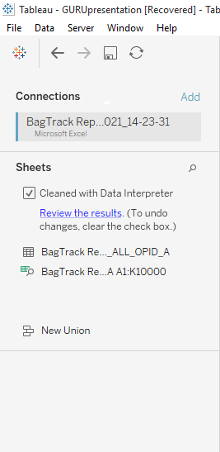
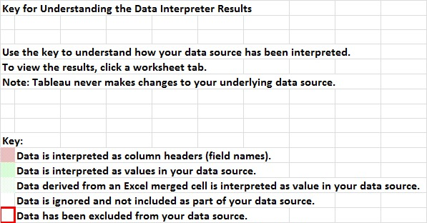
3.1 Data cleansing – By inbuilt data Interpreter of Tableau
By using data interpreter we perform the cleaning on the data

Slide 9

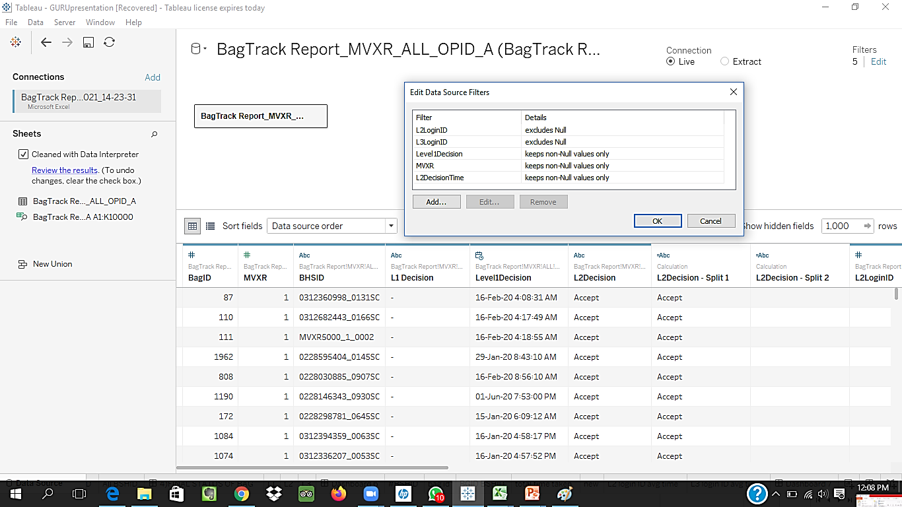
Business pipeline: 3.2 For Handling missing values– Filter in Tableau Data Source
By using filter we cleared the null value from the data

Slide 10


Technical Stacks
Microsoft Excel

Slide 11
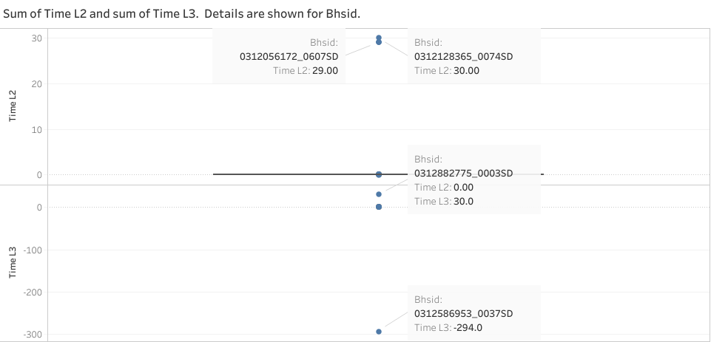
3.1 Outlier Detected– BHISD time taken at L2 and L3 Decision
Detected extreme time taking bags at the L2 and L3 Decision and Eliminated

Slide 12
3.3 Outlier Treatment– Identified and eliminated
BagID | MVXR | BHSID | L1 Decision | Level1Decision | L2Decision | L2LoginID | L2DecisionTime | L3Decision | L3LoginID | L3DecisionTime
84 | 2 | 0312056172_0607SD | Reject | 1/4/20,11:59:00 PM | Accept | 30925 | 1/5/20,12:00:00 AM | - | - | -
1 | 2 | 0312128365_0074SD | Reject | 3/5/20,11:59:00 PM | Accept | 34246 | 3/6/20,12:00:00 AM | - | - | -
1 | 2 | 0312882775_0003SD | Reject | 1/3/20,11:59:00 PM | Reject | 32880 | 1/3/20,11:59:00 PM | Accept | 32652 | 1/4/20,12:00:00 AM
5 | 2 | 0312586953_0037SD | Reject | 2/12/20,11:59:00 PM | Reject | 33326 | 2/12/20,11:59:00 PM | Accept | 4218 | 13/2/20,12:00:09 AM
Identified system generated issues with time. Extreme time value only seems to present where bags getting scanned in the middle of the night specifically during 11:59:00pm to 12:00:00am.

Slide 13
Calculated Fields and Parameters
Calculated field used
Datediff(): To calculate the time difference between Decision Levels
Time Parameter : To calculate operator performance
Description
Calculated Average time for each Decision at L2 and L3 to find out time difference for different decisions.
Average time for each XBIS machine
Total time taken by each BHSID

Slide 14
Data Visualization – Using Tableau Dashboards

Slide 15
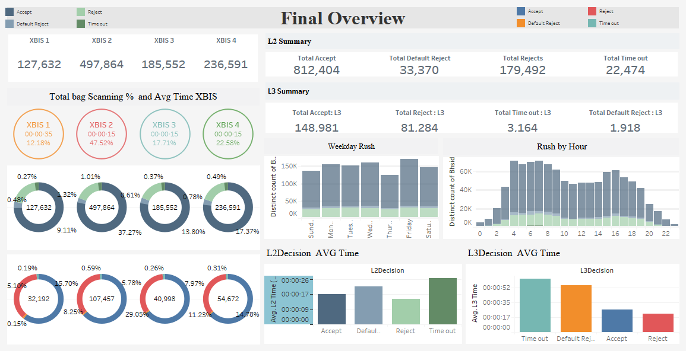
Operations based on machines, time taken.

Slide 16
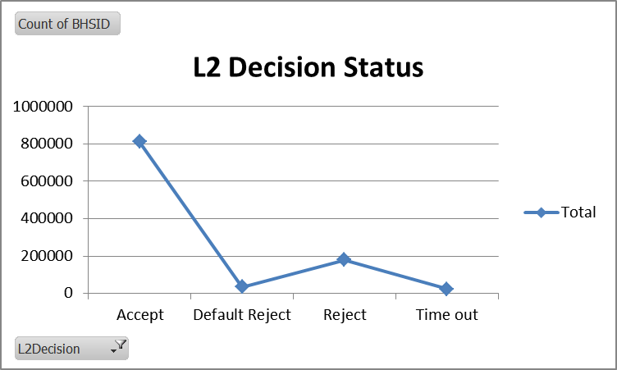
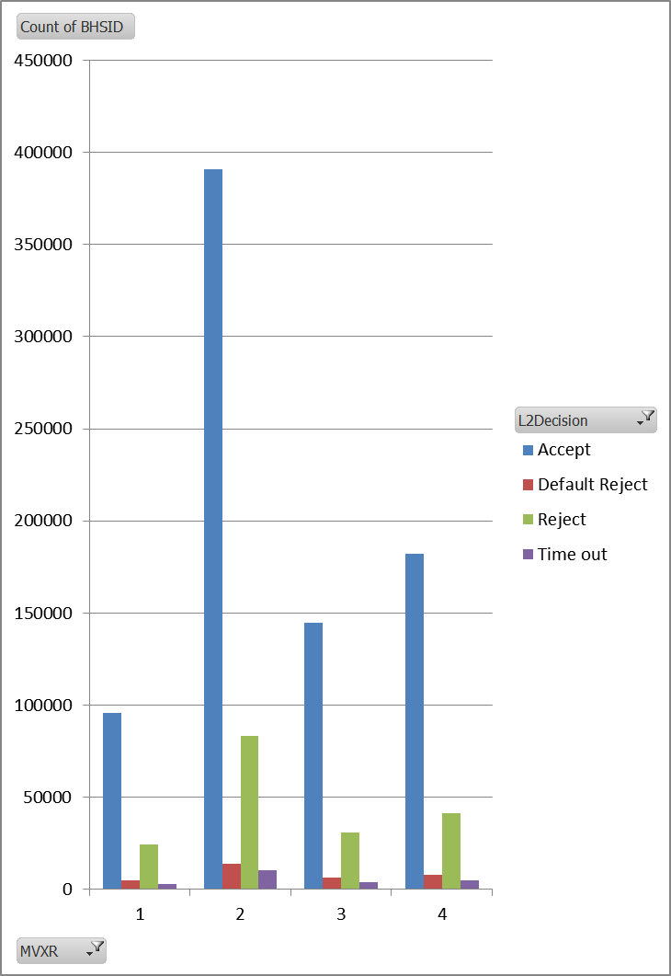
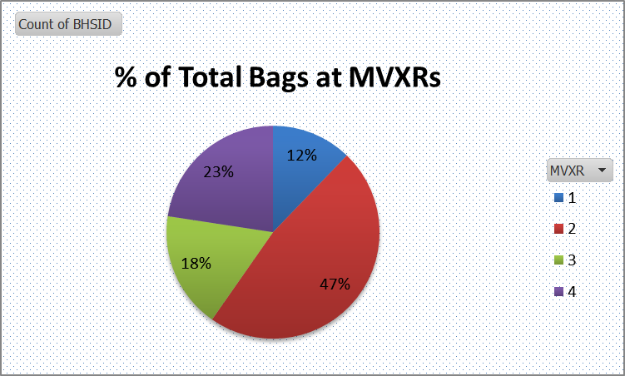
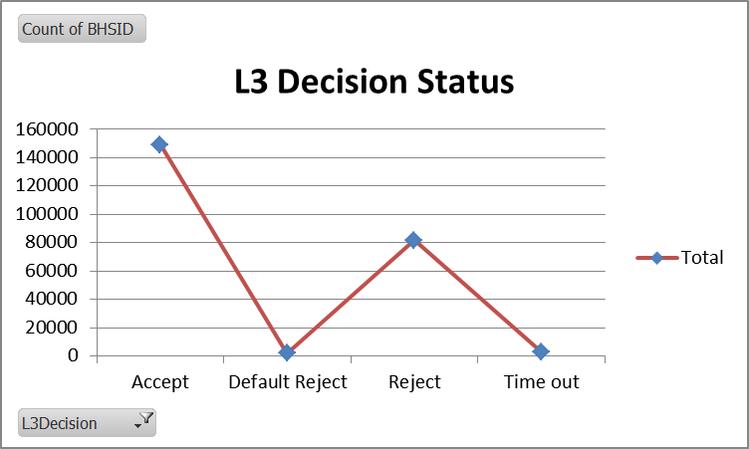
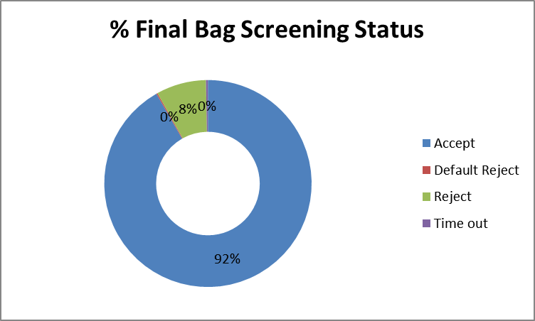
Final bag Screening
47% of the total bags are getting scanned at XBIS 2 and only 12 % are getting scanned at XBIS 1.
92 % of the total bags are getting accepted and 8% are getting rejected

Slide 17
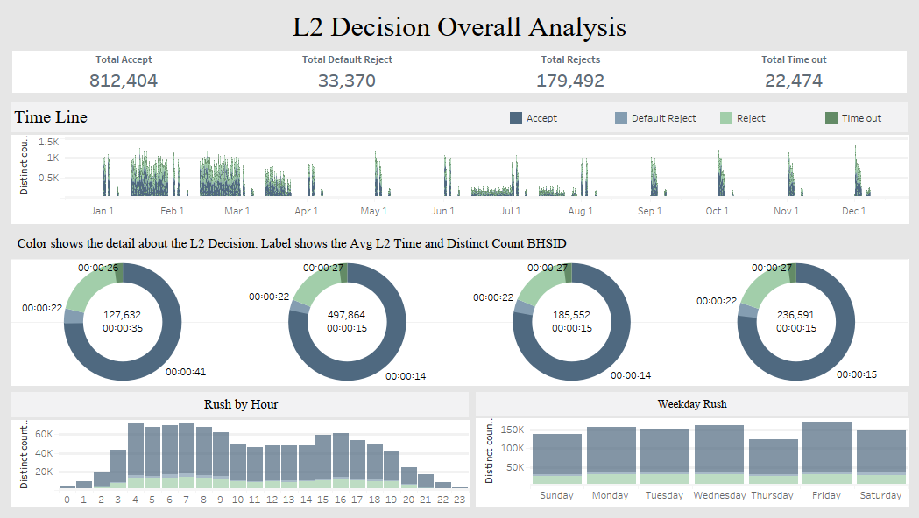

Slide 18
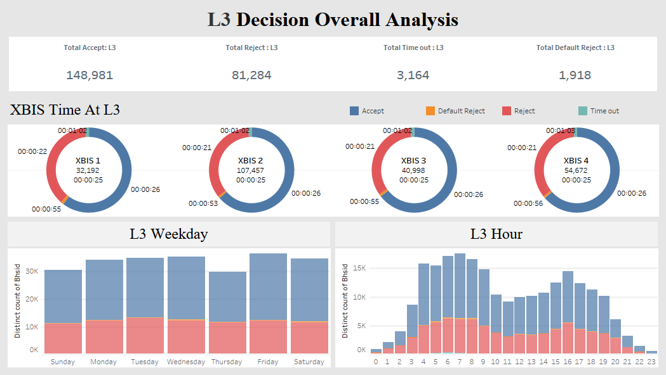

Slide 19
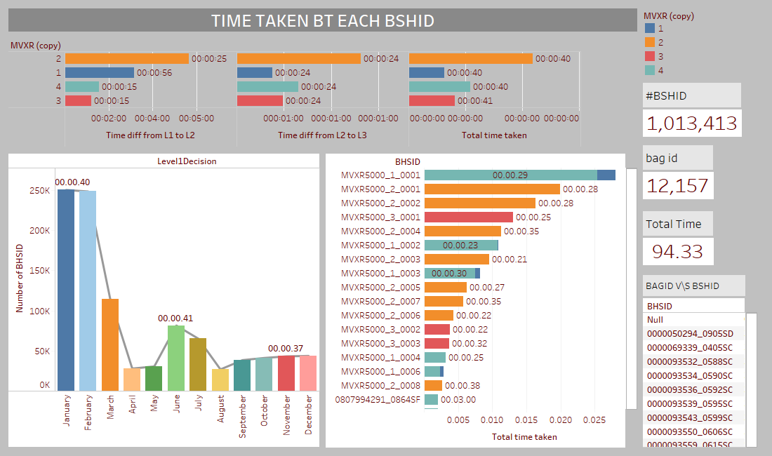
Number of passenger at the airport are highest in January and February almost 250 K but rest of the year number of passengers are less then 100k.
XBIS 1 taking the maximum time for L2 Decision. And after removing the outliers the maximum time taken by BHSID is 30 Seconds.

Slide 20
Operations based on Login ids/, time taken. To find out total operation performed on the baggage

Slide 21
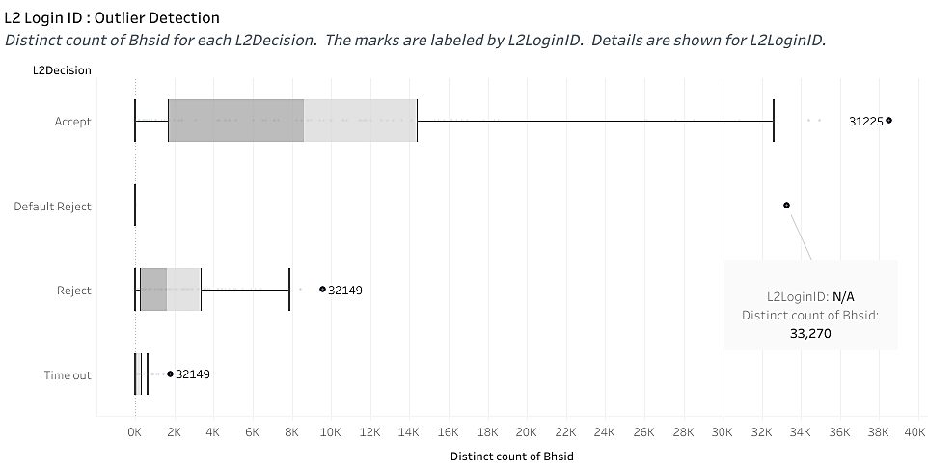
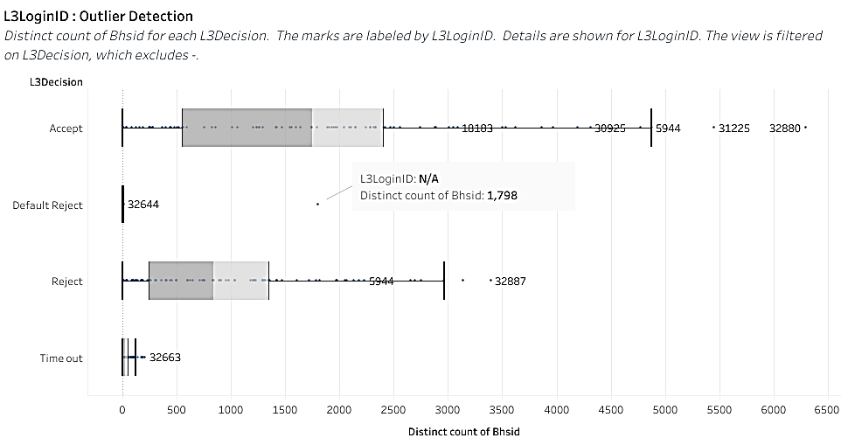
Outlier : L2LoginID and L3LoginID
Inferences
1- Operator with Login ID 31225 has extreme number of accepted bags at both the Decision level L2 and L3
2- Most Default Reject Bags does not have any login ID at both L2 and L3 Decision

Slide 22
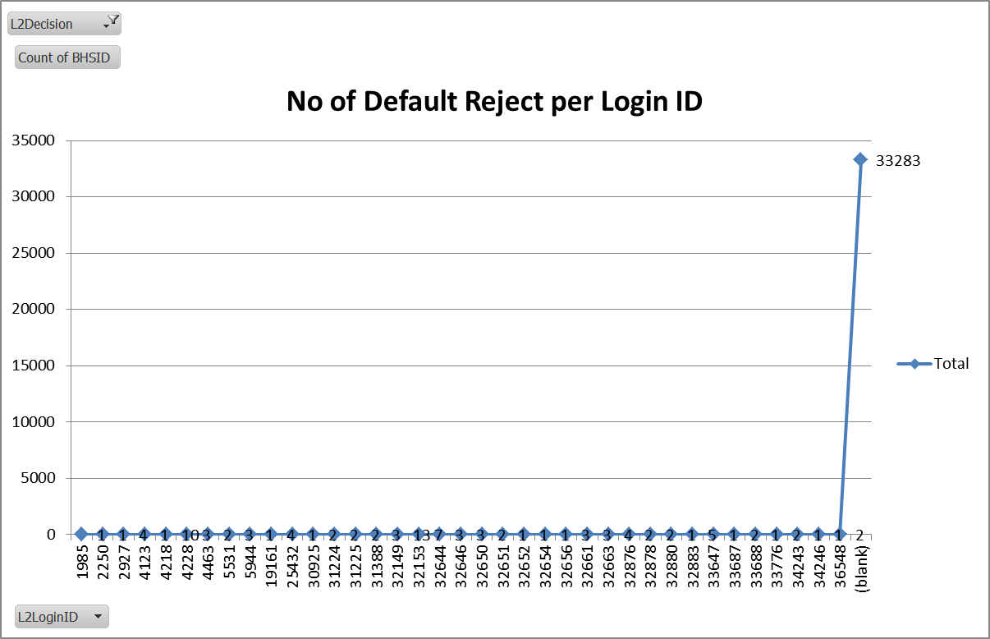
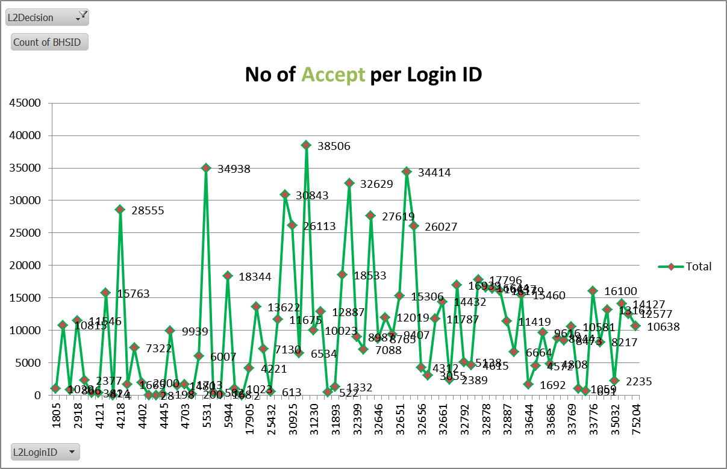
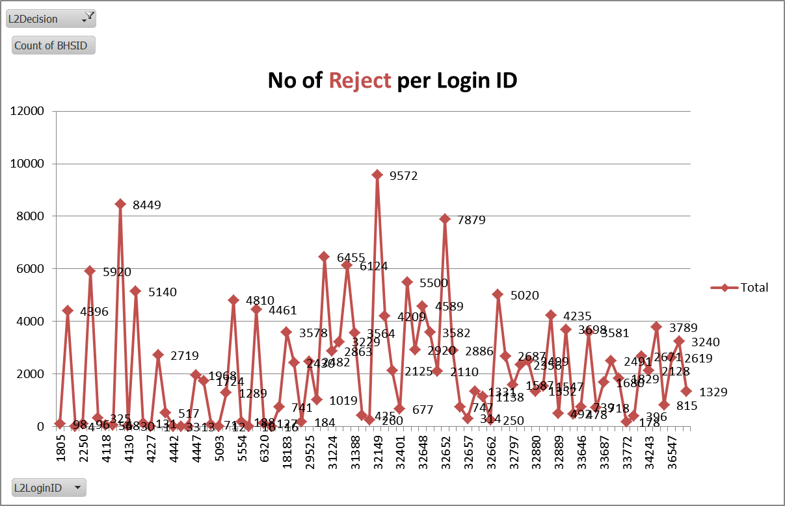
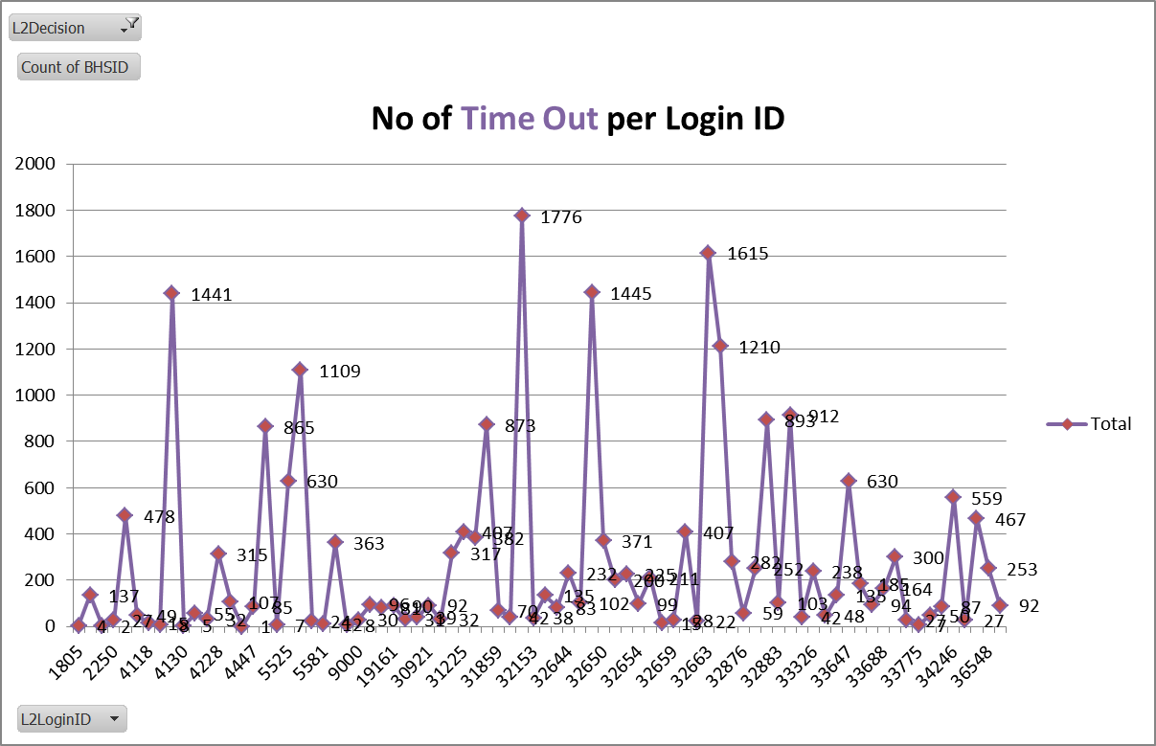
Data Understanding: L2Login ID
The above pattern can be only seen in Default Reject. Blank login id is only present in the default Reject.
Total Default Rejects are 33384, and 33283 does not have any login ID

Slide 23
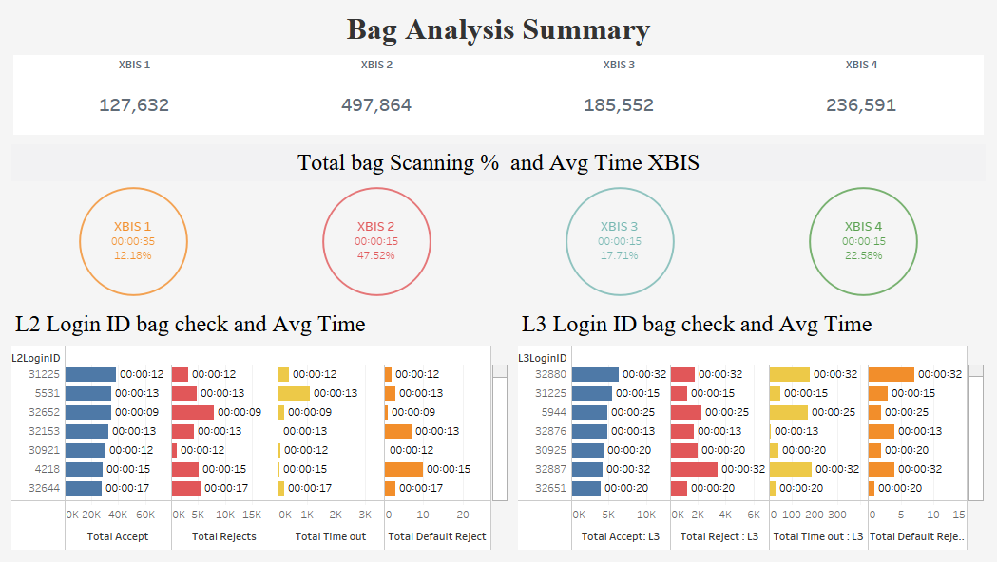
To identify the status & time limits

Slide 24
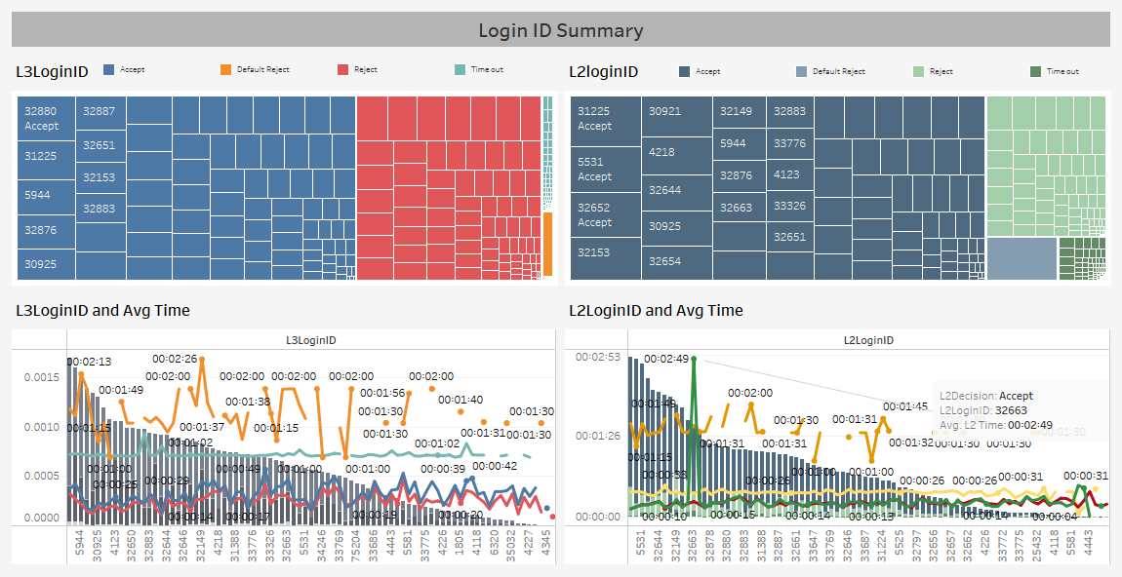

Slide 25
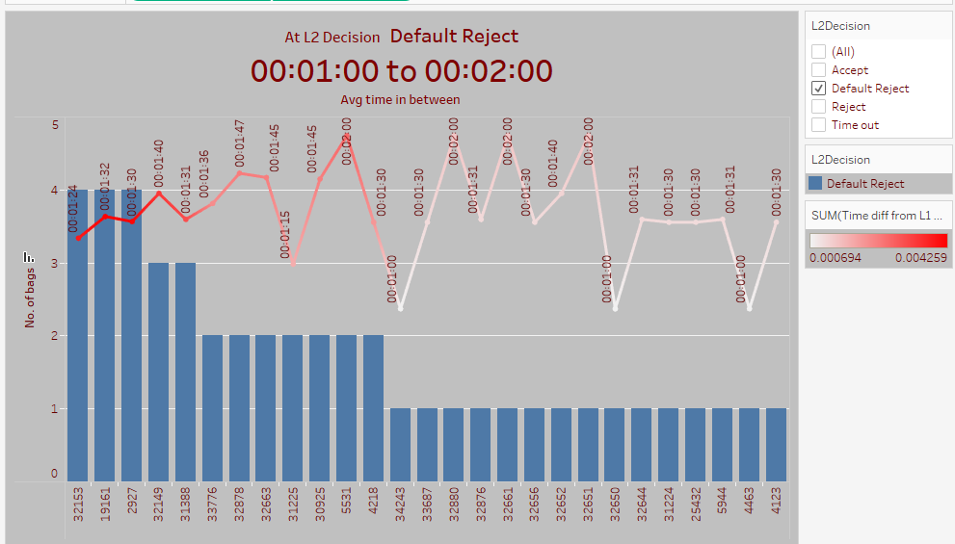
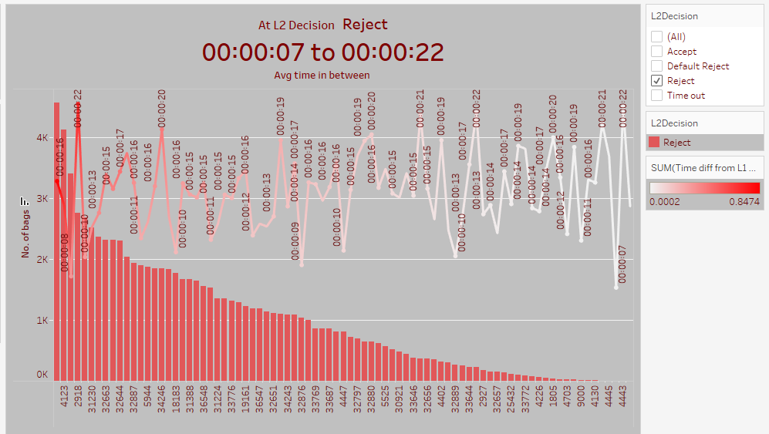
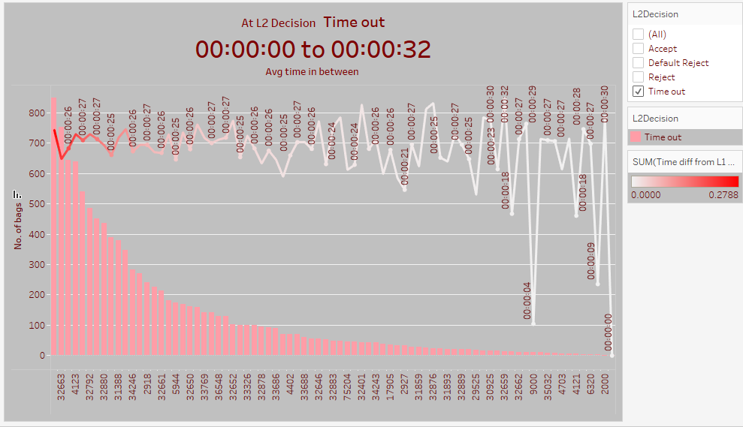
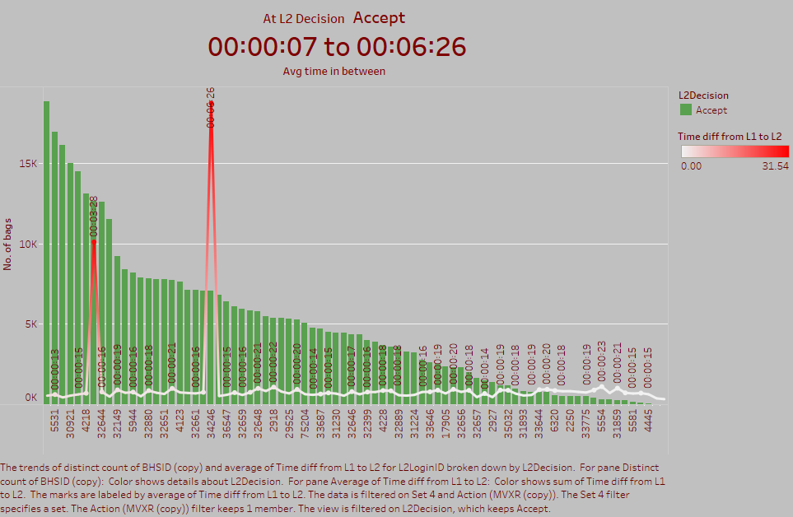
Avg. Time taken for L2Decision by L2Login ID
It can be observed that after 1 min the bags are automatically getting the status of Default Reject.
At L2 Decision Time out is made in 0 seconds, bags are skipping the decision

Slide 26
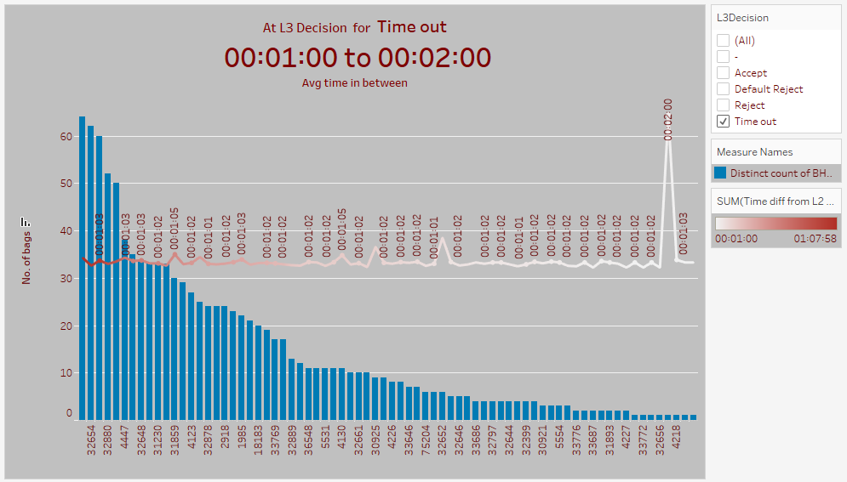
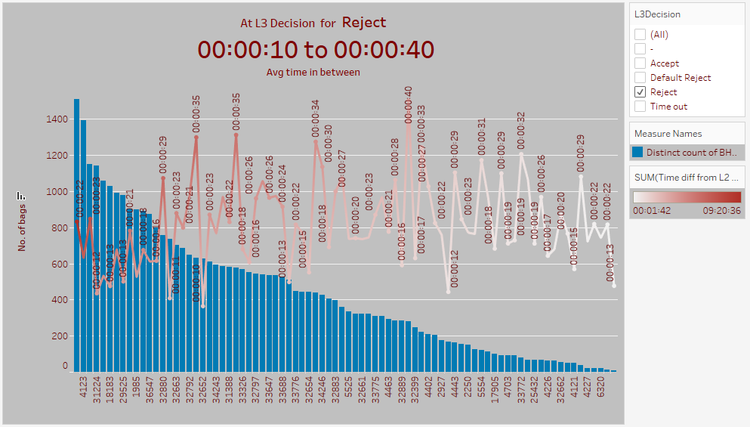
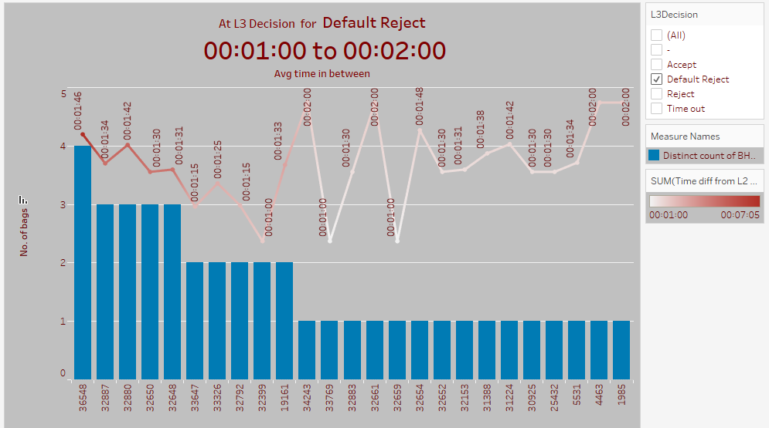
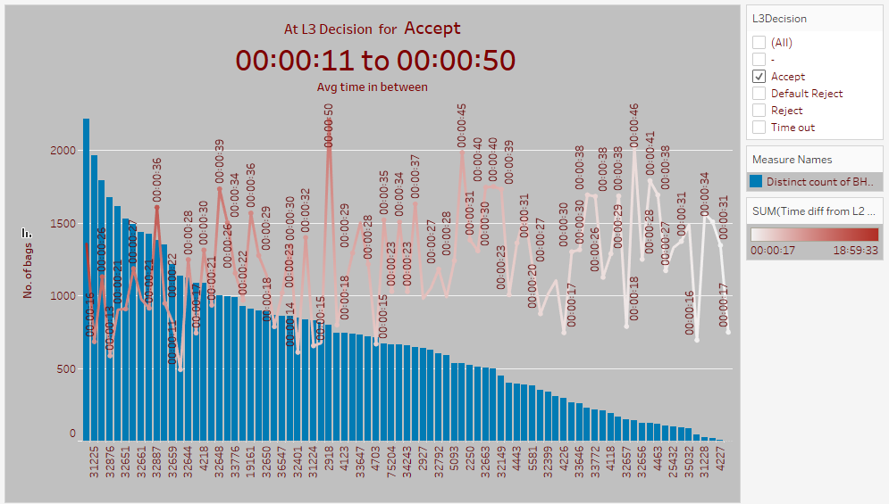
Avg. Time taken for L3Decision by L3Login ID
After looking at the above graph we can say that after 1 min bags automatically gets Default Reject.
Here Time out decision time also taking more than 1 min

Slide 27
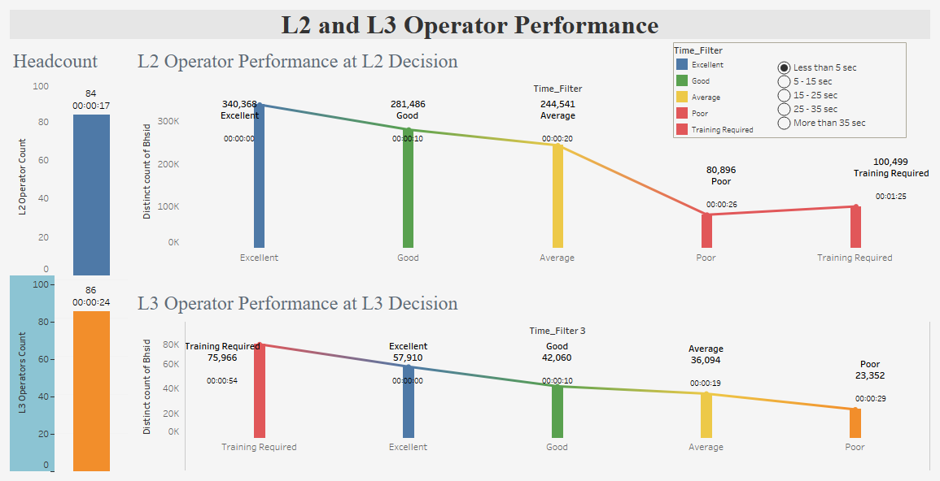

Slide 28
Final Inferences
More than 47% bags are getting scanned at XBIS 2 and 12 % at XBIS 1. Hence we can say than there is no equal distribution of bags among machines
Identified system generated issues with time. Extreme time value only seems to present where bags getting scanned in the middle of the night specifically during 11:59:00pm to 12:00:00am.
Average time taken by bags at XBIS 1 is 35 seconds which 20 seconds higher than other machines.
Operators at L2 Decision are taking less time then operators at L3 decisions.
Maximum in rush of baggage during January, February and March months of the year. We have also analyzed that beginning of every month are the most busy time of the month. This pattern can be seen through out the year.

Slide 29
Future scope
Training of operators at both the levels L2 and L3 is required to increase the accuracy of baggage scanning especially at L3 Decision.
To minimize the time taken for maximum bag screening, the bags should be evenly distributed among the XBIS machines.
To handle the maximum in rush of baggage in the months of January, February & March, and in the beginning of the month throughout the year, the business should plan ahead for optimum handling of baggage.

Slide 30


